Slide 1
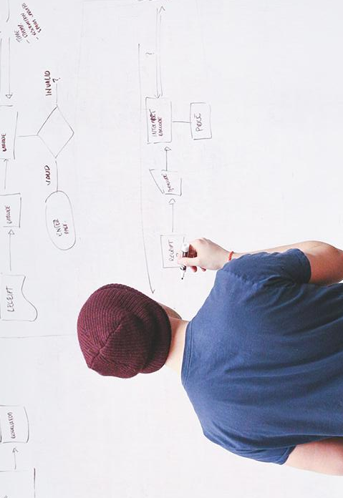
“Data scientists are involved with gathering data, massaging it into a tractable form, making it tell its story, and presenting that story to others.”
– Mike Loukides,
Editor, O’Reilly Media
Notes:
Team Introductions

Slide 2
Canadians & Data Literacy
Why Care?
Notes:
The Problem we are trying to solve
How does your game or gamified procedure benefit and engage with Canadians?
General public doesn’t know what we do/have. Limited visibility
If they don’t know why it is important then they are less likely to respond (decreased response rates across the department)

Slide 3
11,132,923
Website visits to statcan.gc.ca
Notes:
Mention a lot of this might be from industry viewers

Slide 4
68,620 publications
1,221 Dailys
157 surveys
Available to Canadians
Released in 2018
In collection currently
Notes:
Again discuss the fact that a lot of our data is from industry for industry

Slide 5
User Stories
Why Care?
Notes:
The Problem we are trying to solve
How does your game or gamified procedure benefit and engage with Canadians?

Slide 6
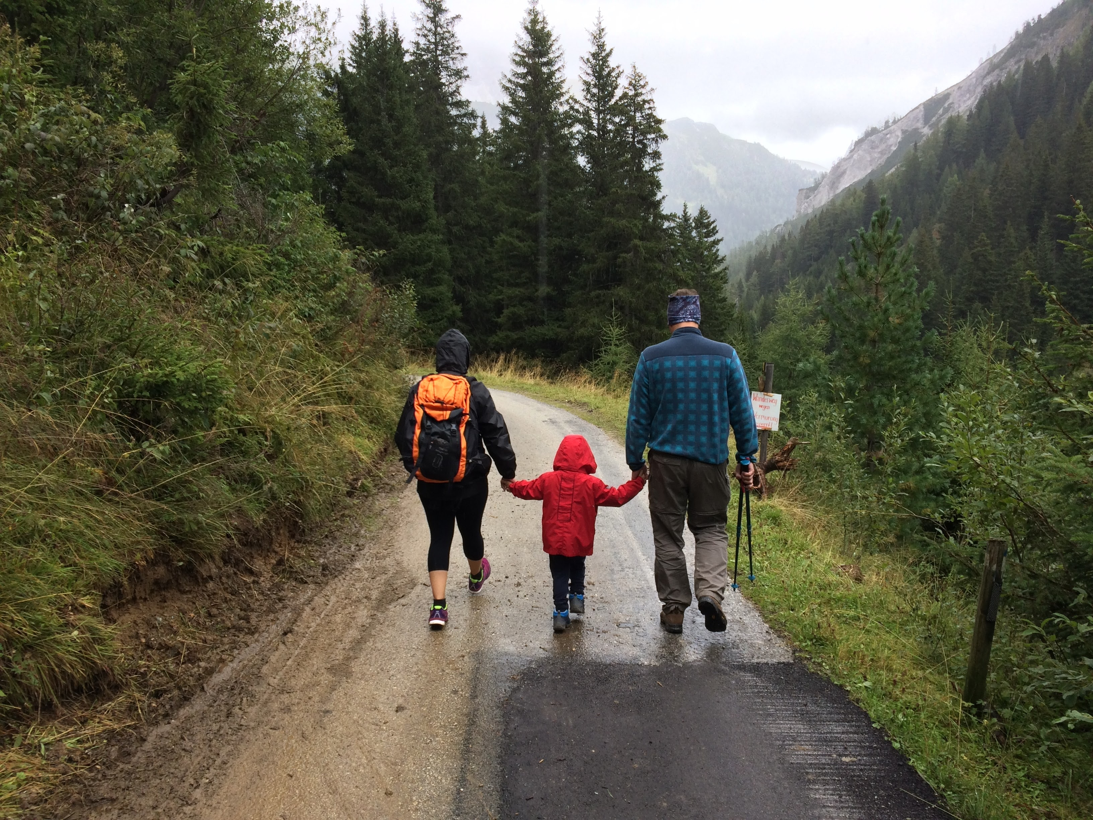
Janice & Dean
Family in Halifax, NS
Notes:
- Use StatCan data for family fun and educating children

Slide 7

Harpreet
Teacher in Toronto, ON
Notes:
- Use Statcan Data as teaching tool to help youth understand the important of a national statistics agency and the data produced.

Slide 8

Janly
Dutch Farmer
Notes:
Use StatCan data as a learning tool on airline in order to familiarize self with Canadian statistics.
Mention O Canada prior to next slide – something about Janly learning the national anthem before the citizenship test

Slide 9

Know Canada!
Notes:
Team Name -

Slide 10
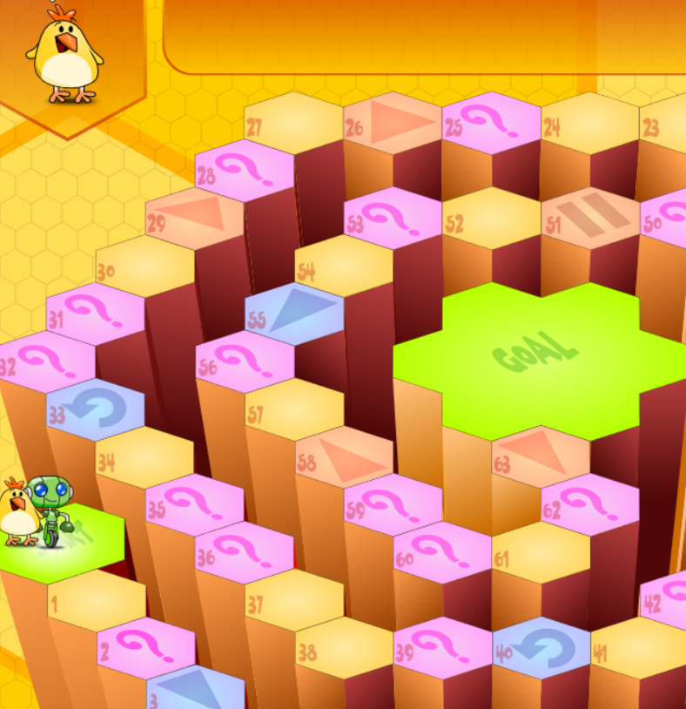
Know Canada Mockup
Notes:
Brief explanation of what done
Used github javascript project to build our mockup
Initially survey groups submit their own questions
End goal Algorithm or even AI to generate questions and get answers from the NDM tables – by bringing in the data, for example via the StatCan API, and automatically analyzing it to determine eg highest number of imports of a given commodity and use that to determine the answer, and can also find incorrect answers from the same data
Can also use algorithm, machine learning to tailor questions based on user responses
Tailor questions based on user input of location, age, etc.
Potential collaboration with other government agencies for Qs and data
Will collect demographic information and potential to collect other information during gameplay (i.e. what categories people don’t know about)
-ex. No one knows about trade – build a bigger public presence with infographs and media outreach when learning this.

Slide 11
Troubleshooting
Identified Risks

Slide 12
Risk – IT Security
Injection Attack
Notes:
-if collecting data then the response database that collects user response data needs to be adequately secure to statcan standards

Slide 13
Risk – IT Security
Risk:
Low
Injection Attack
Notes:
-if collecting data then the response database that collects user response data needs to be adequately secure to statcan standards

Slide 14
Risk – IT Security
Risk:
Low
Injection Attack
Potential:
High
Notes:
-if collecting data then the response database that collects user response data needs to be adequately secure to statcan standards

Slide 15
Risk – IT Security
Risk:
Low
Injection Attack
Sanitize User Inputs
Potential:
High
Notes:
-if collecting data then the response database that collects user response data needs to be adequately secure to statcan standards

Slide 16
Risk – Public Perception
Intrusive/ Messaging
Notes:
-if collecting data then the response database that collects user response data needs to be adequately secure to statcan standards

Slide 17
Risk – Public Perception
Risk:
Medium
Intrusive/ Messaging
Notes:
-if collecting data then the response database that collects user response data needs to be adequately secure to statcan standards

Slide 18
Risk – Public Perception
Risk:
Medium
Intrusive/ Messaging
Potential:
Medium
Notes:
-if collecting data then the response database that collects user response data needs to be adequately secure to statcan standards

Slide 19
Risk – Public Perception
Risk:
Medium
Intrusive/ Messaging
Explict Terms of Use
Potential:
Medium
Notes:
-if collecting data then the response database that collects user response data needs to be adequately secure to statcan standards

Slide 20
Risk – System Failure
User Overload
Notes:
Aka game crashes

Slide 21
Risk – IT Security
Risk:
Medium
User Overload
Notes:
-if collecting data then the response database that collects user response data needs to be adequately secure to statcan standards

Slide 22
Risk – IT Security
Risk:
Medium
User Overload
Potential:
Low
Notes:
-if collecting data then the response database that collects user response data needs to be adequately secure to statcan standards

Slide 23
Risk – IT Security
Risk:
Medium
User Overload
Cloud Based Game
Potential:
Low
Notes:
-if collecting data then the response database that collects user response data needs to be adequately secure to statcan standards

Slide 24
Value Proposition to StatsCan
Data Literacy
Response Analysis
Modular
Interdepartmental
Cost Recovery
Notes:
Testing a different approach

Slide 25

Value Proposition to StatsCan
Data Literacy
Response Analysis
Modular
Interdepartmental
Cost Recovery
Notes:
Testing a different approach

Slide 26
Value Proposition to StatsCan
Data Literacy
Response Analysis
Modular
Interdepartmental
Cost Recovery
Demographic Information
Categorical Analysis
Notes:
Testing a different approach

Slide 27

Value Proposition to StatsCan
Data Literacy
Response Analysis
Modular
Interdepartmental
Cost Recovery
Notes:
Testing a different approach

Slide 28





Value Proposition to StatsCan
Data Literacy
Response Analysis
Modular
Interdepartmental
Cost Recovery
Notes:
Testing a different approach

Slide 29
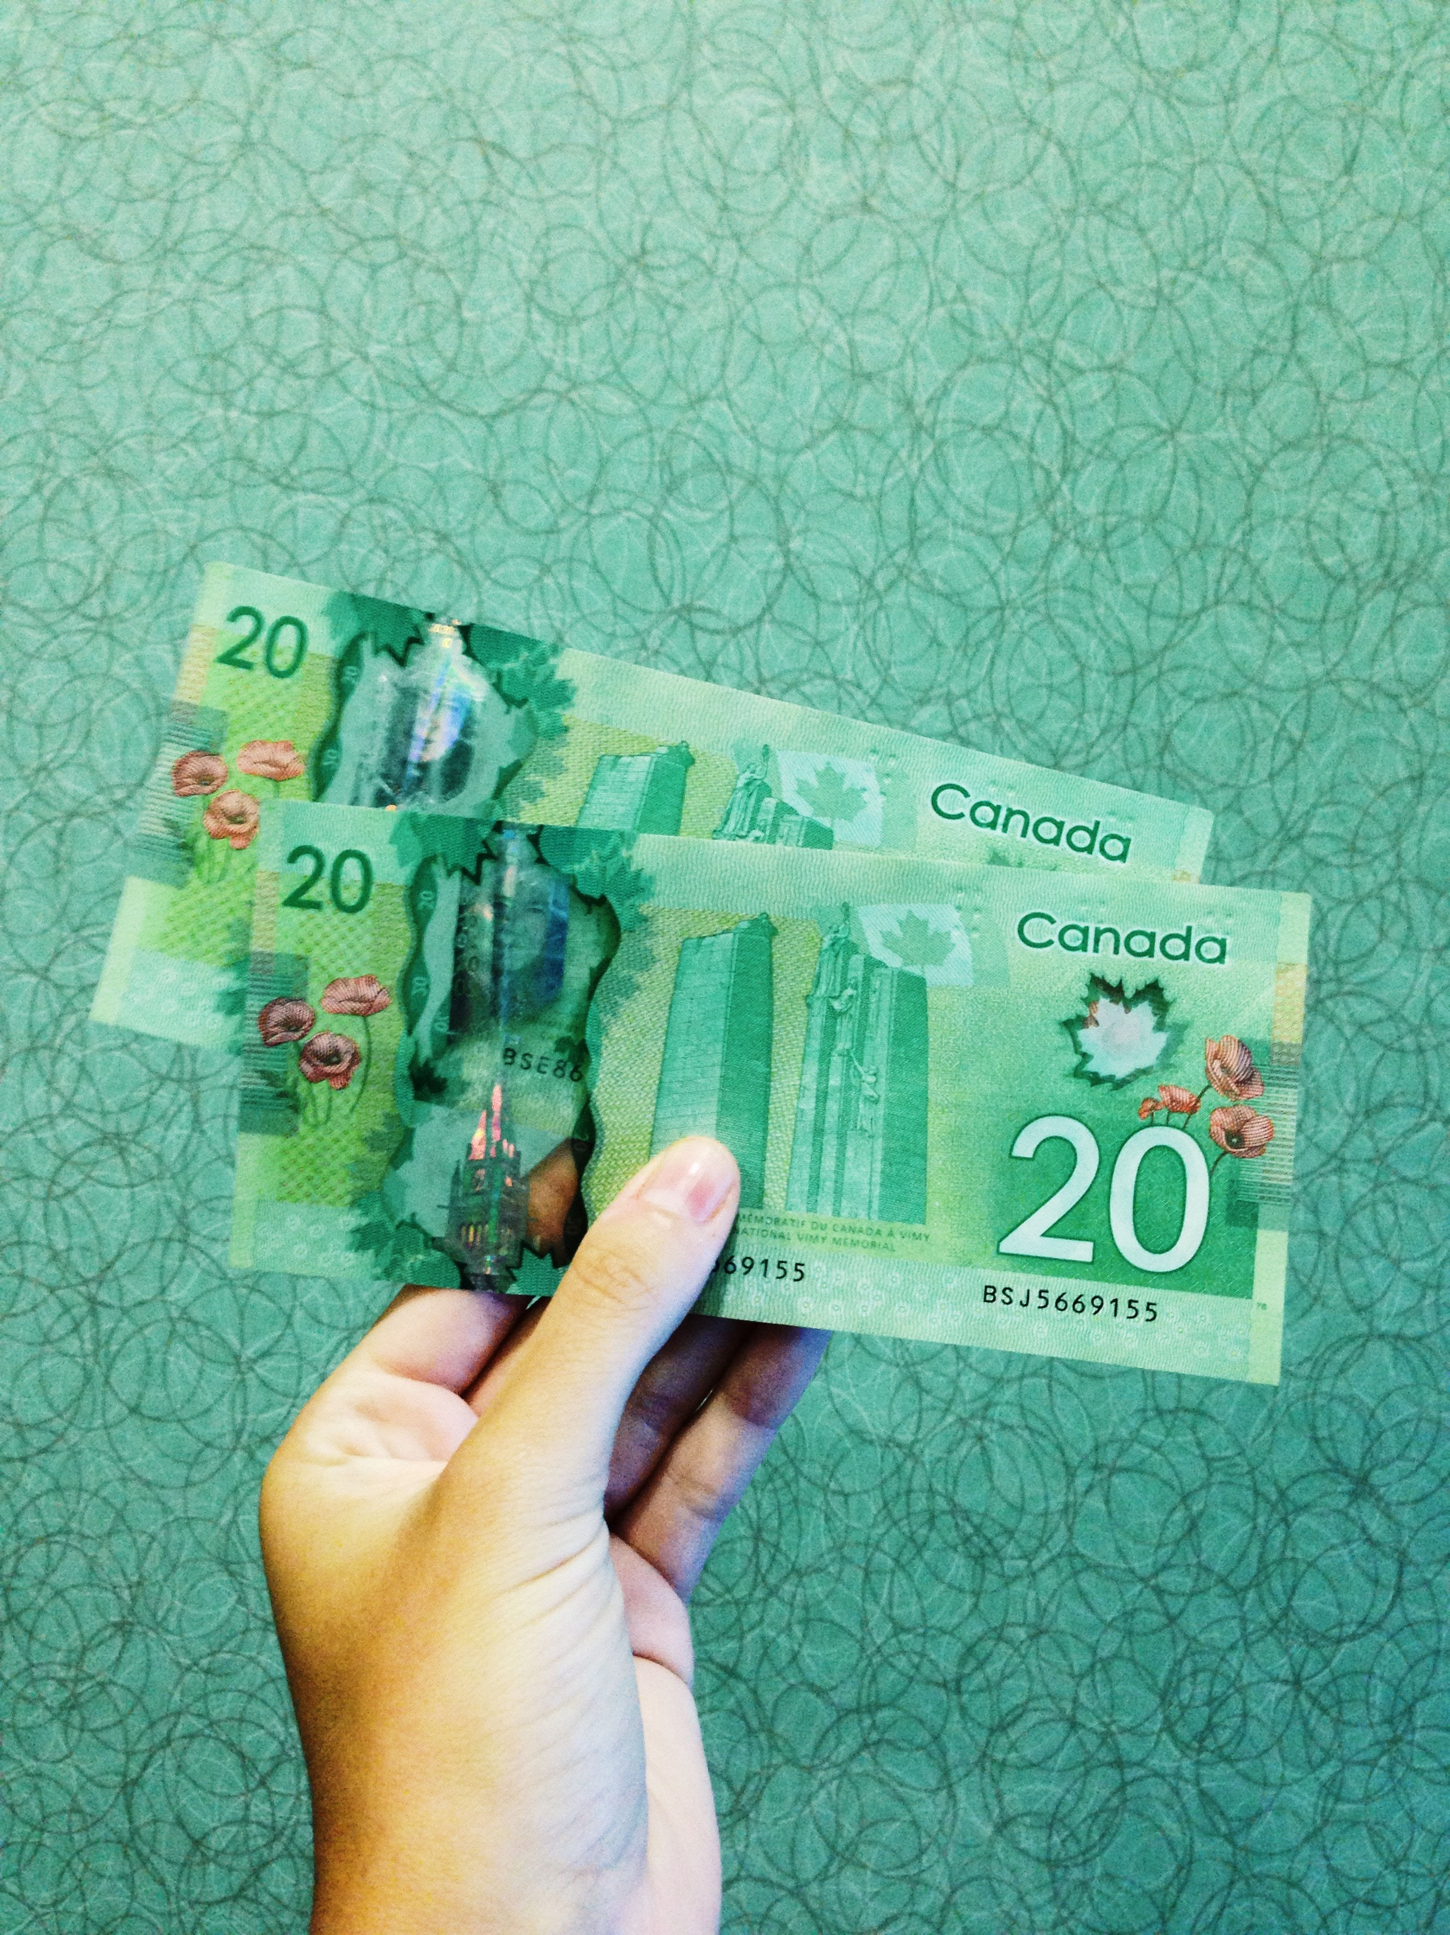
Value Proposition to StatsCan
Data Literacy
Response Analysis
Modular
Interdepartmental
Cost Recovery
Notes:
Testing a different approach

Slide 30
THANKS!
Any questions?

